Slide 1
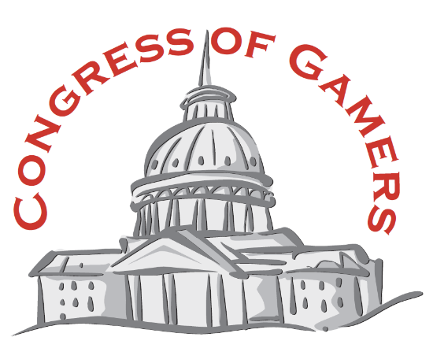
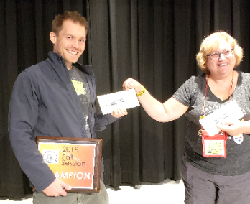
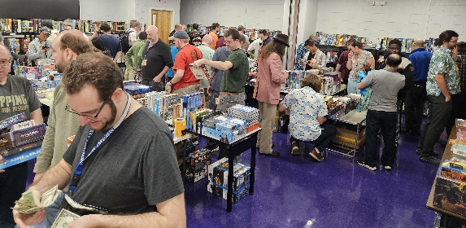
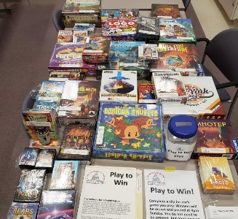
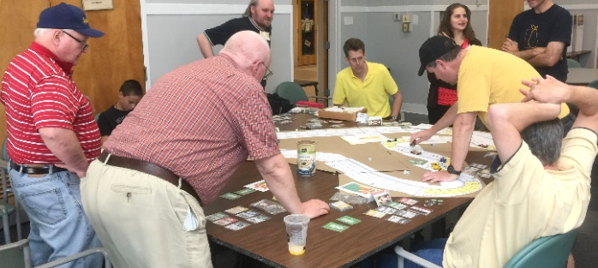
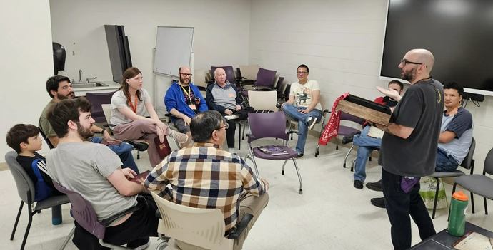
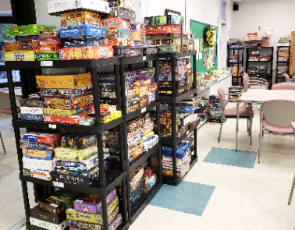
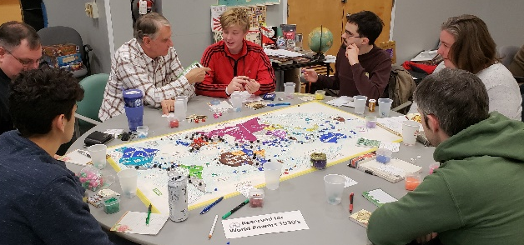
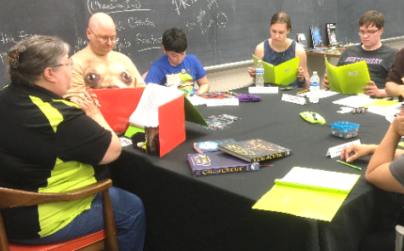
The local conventions
for Gamers in Maryland,
Virginia, DC and Beyond.
emsps.com/cog
info@emsps.com
Jun 20-25, 2026 Cruise Session, Baltimore to Bermuda
Oct 10-11, 2026 Rockville Senior Center, Rockville, MD
Jan 16-17, 2027 Rockville Senior Center, Rockville, MD
May 1-2, 2027 Rockville Senior Center, Rockville, MD
Win tourney prizes Sell your games Play to Win
Special events Social Games
Hot game library Play Test with Designers D&D, RPG
And so MUCH more! FREE parking!

Slide 2
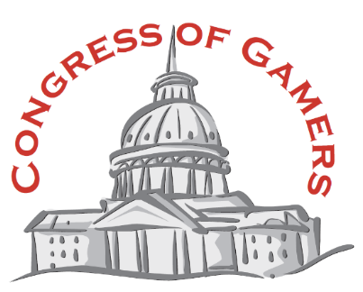
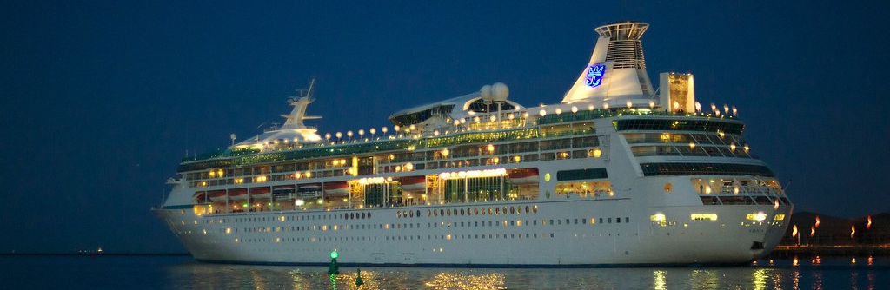
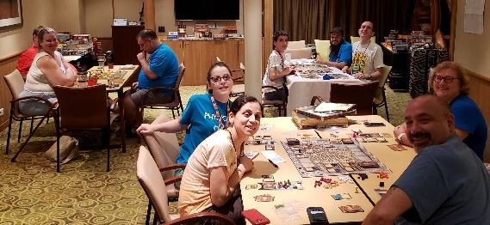

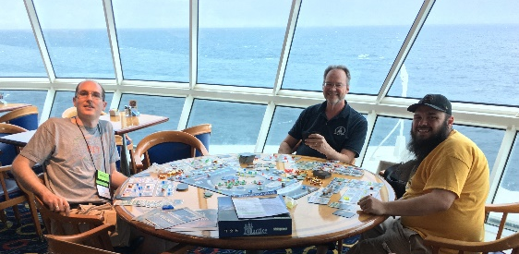
Board Game Cruise!
Baltimore to Bermuda, June 20-25, 2026
Details on emsps.com/cog/cruise
Royal Carribean’s
Vision of the Seas
Royal Caribbean’s
Grandeur of the Seas
Just park your car and walk onto the ship. Your dream vacation starts immediately! A conference room is reserved for our group.
Baltimore-Bermuda-Baltimore
Everything cruises offer, plus
board gaming!
Contact WhitneyZimdahl@gmail.com
We are group #2391037 with a rate of $637 per person plus fees for an interior state room. Fully refundable deposit before 3/22/26.
Or, book any room you please!

